Slide 1
ELEMENTARY STATISTICS, BLUMAN
Area Under Normal Curve Using Table (Example 4)
© 2019 McGraw-Hill Education. All rights reserved. Authorized only for instructor use in the classroom. No reproduction or further distribution permitted without the prior written consent of McGraw-Hill Education.

Slide 2
Objectives for this PowerPoint
Learn how to find probabilities associated with a normally distributed variable using the normal distribution table.

Slide 3
Example (1)
Using the normal distribution table find the probability that a randomly selected standardized value from a normally distributed variable is between -2.07 and 1.88.

Slide 4
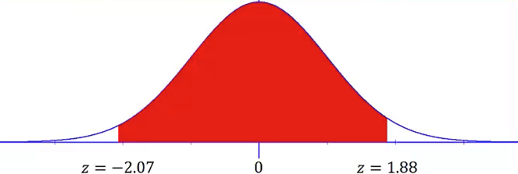
Example (2)
This can also be described as finding the area under the normal curve between 2.07 standard deviations to the left of the mean and 1.88 standard deviations to the right of the mean.

Slide 5
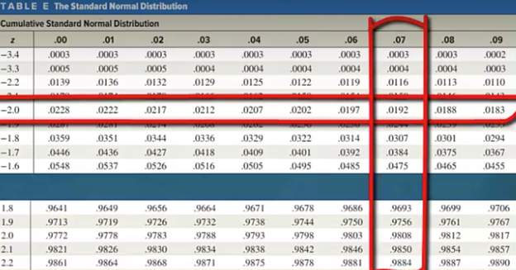
Example (3)
The cumulative normal distribution table gives us probabilities associated with z-values. We are looking for the probability associated with the z-score -2.07. We will find the entry in the table where the row -2.0 intersects with the column .07

Slide 6
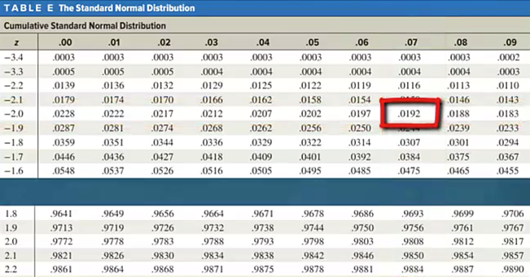
Example (4)
We find this value to be .0192

Slide 7
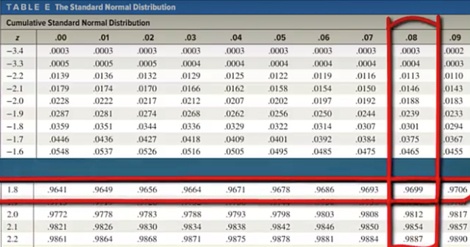
Example (5)
We will also look for the value associated with the z-score 1.88. We find the entry where the row labeled 1.8 intersects with the column labeled .08.

Slide 8

Example (6)
The graph at the bottom of the table shows that these 4 decimal place values in the body of the table correspond to the area under the curve that extends from the left-tail up to the z-score.

Slide 9
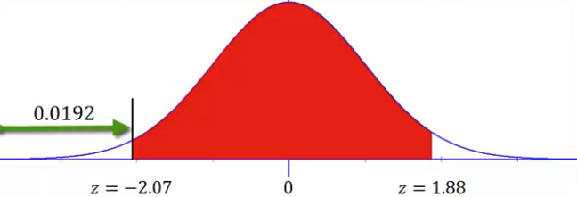
Example (7)
The value 0.0192 would correspond to the area under the curve that extends from the left-tail to the z-score -2.07

Slide 10
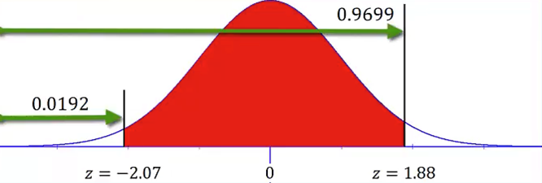

Example (8)
The value 0.9699 would correspond to the area under the curve that extends from the left-tail to the z-score 1.88.
$$P(−2.07<z<1.88)$$

Slide 11
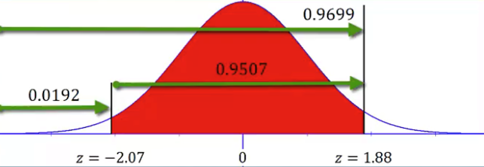
Example (9)
But our requested probability calls for the area that extends from the z-score -2.07 up to the z-score 1.88.

Slide 12
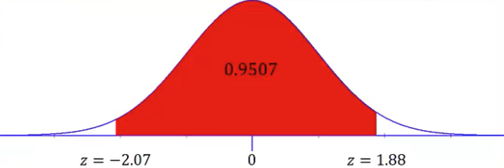
Example (10)
So the area that we are looking for is the difference between these values which is 0.9507.

Slide 13
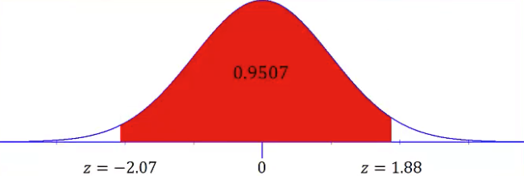

Example (11)
In probability notation we would write the probability as the following:
$$P\left(−2.07<z<1.88\right)=0.9699−0.0192=0.9507$$

Slide 14
Summary
In this PowerPoint we learned how to find probabilities associated with a normally distributed variable using the normal distribution table.

